Slide 1
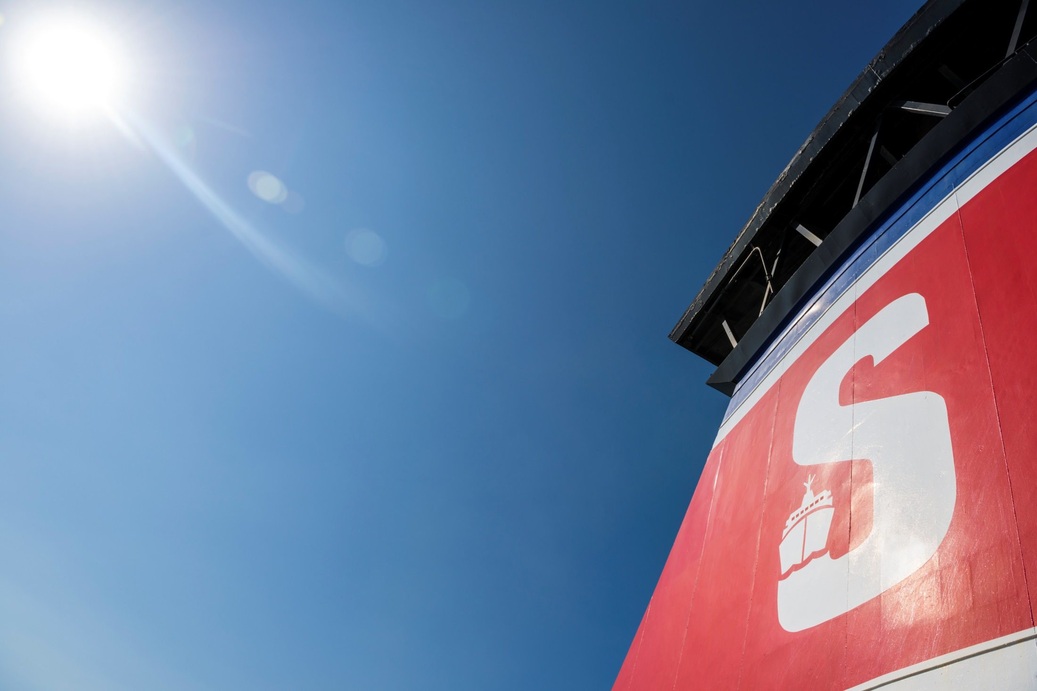

Slide 2
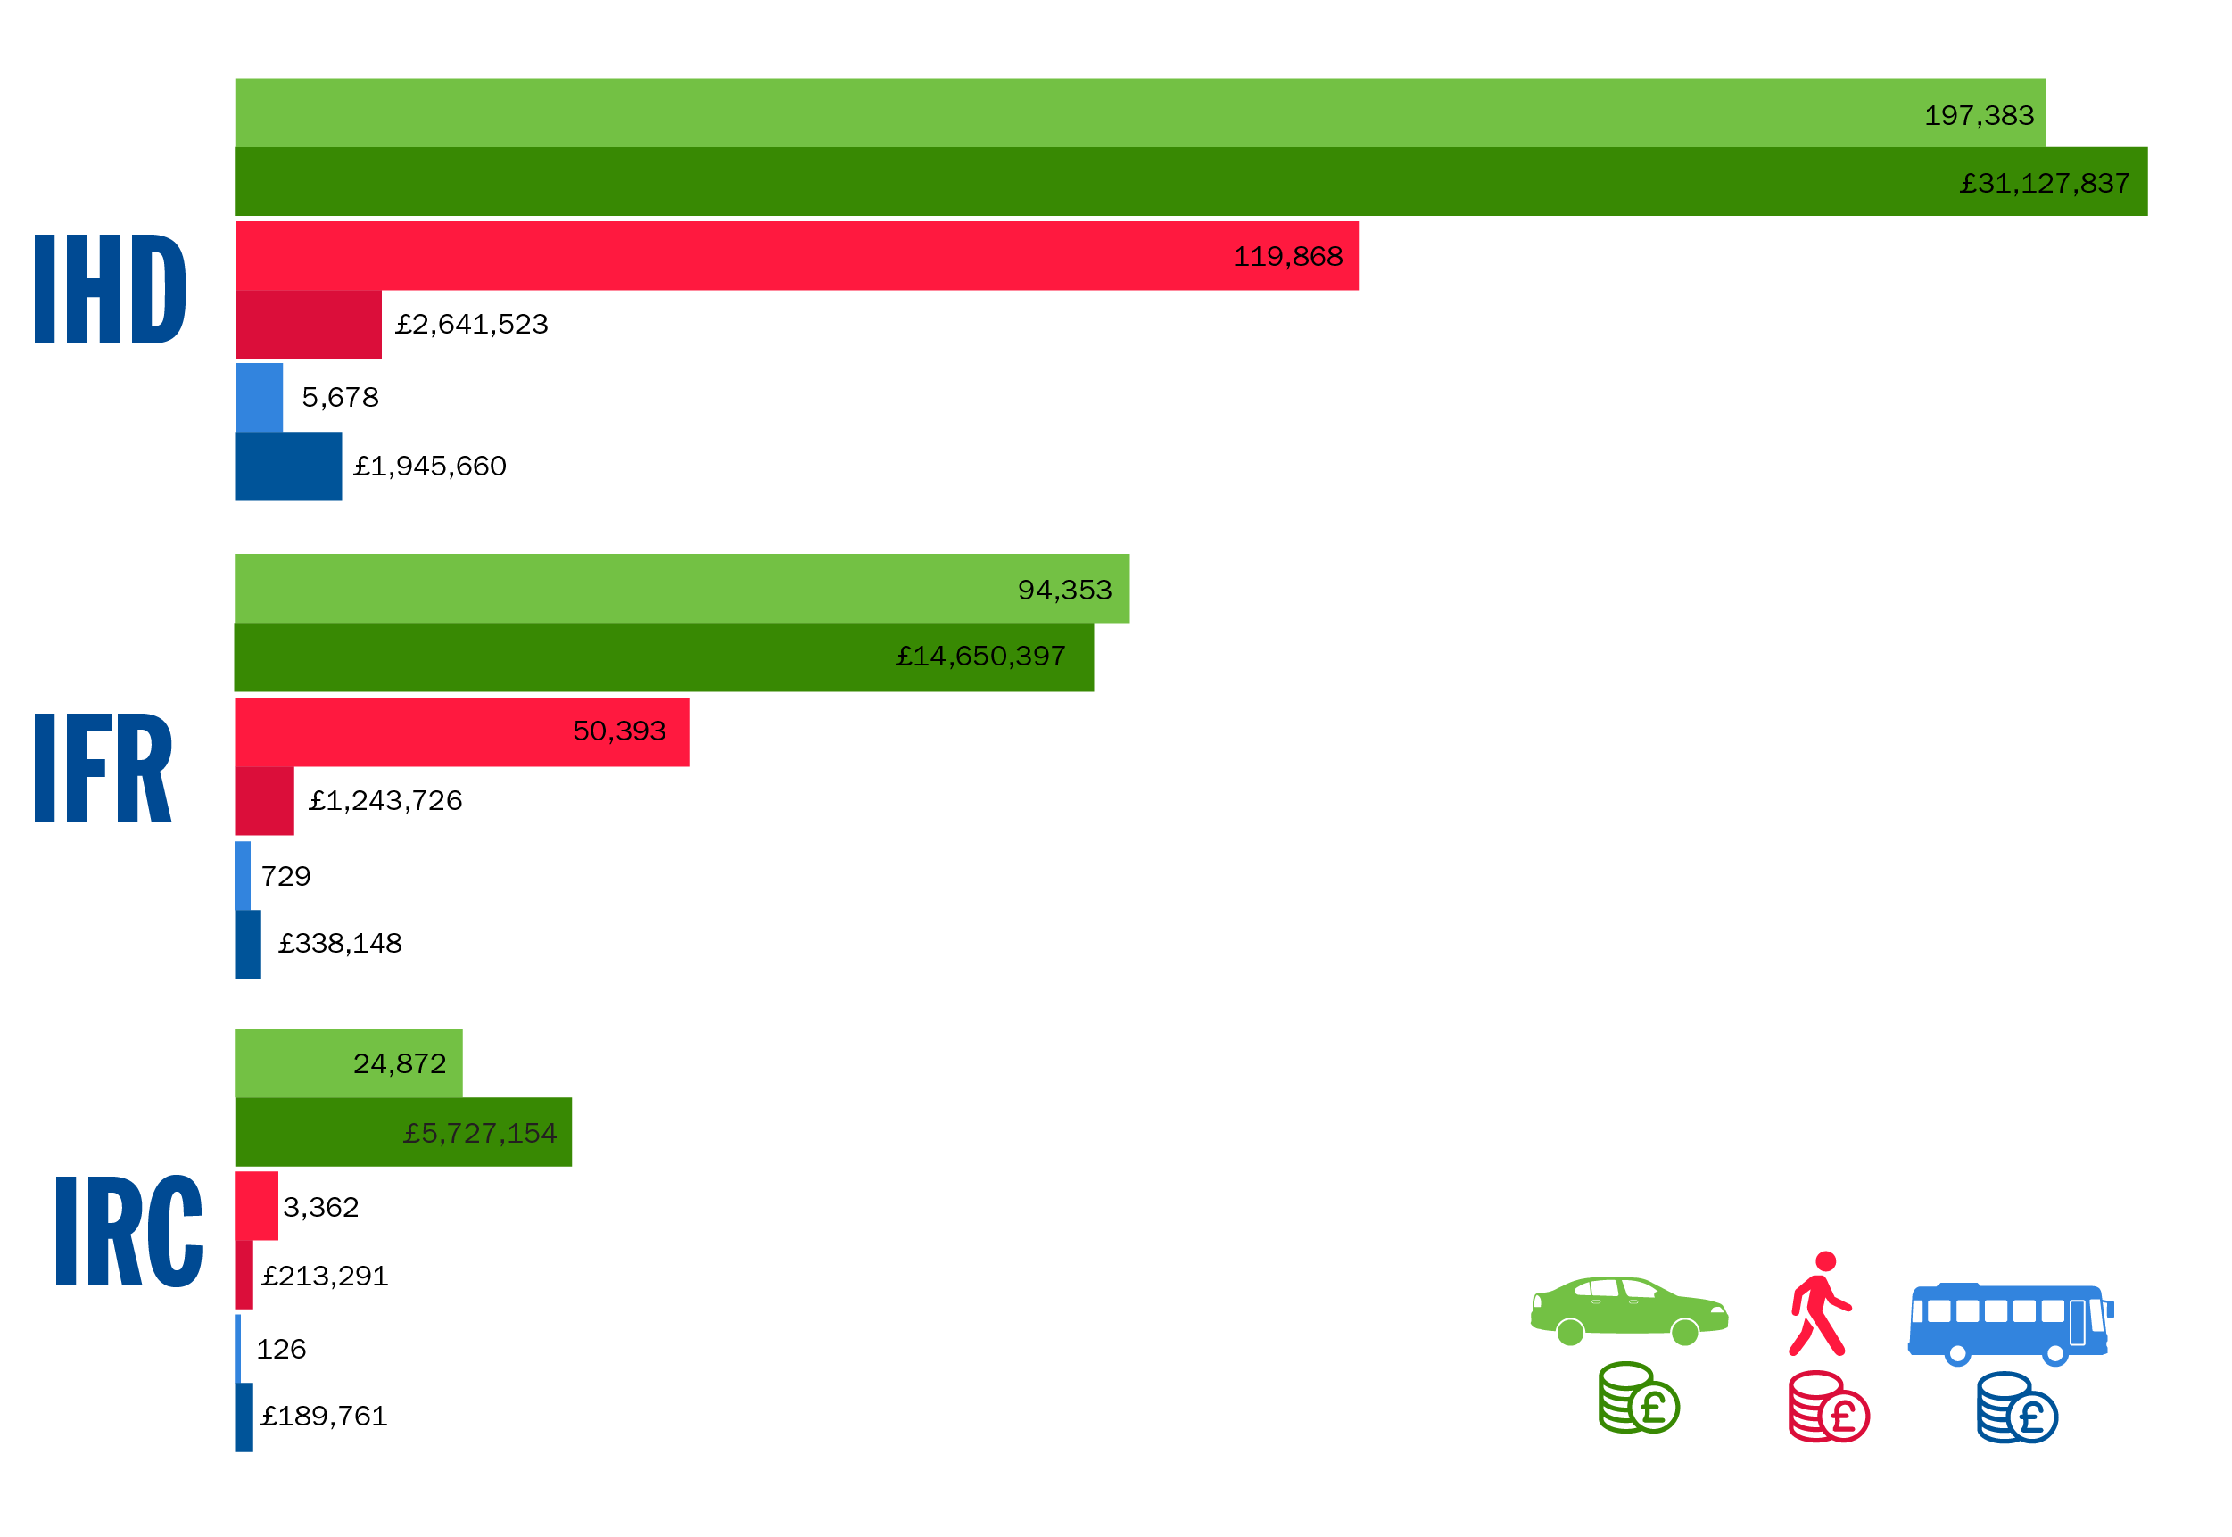
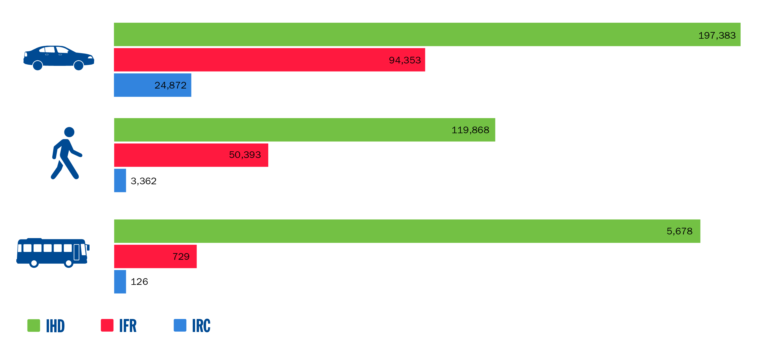
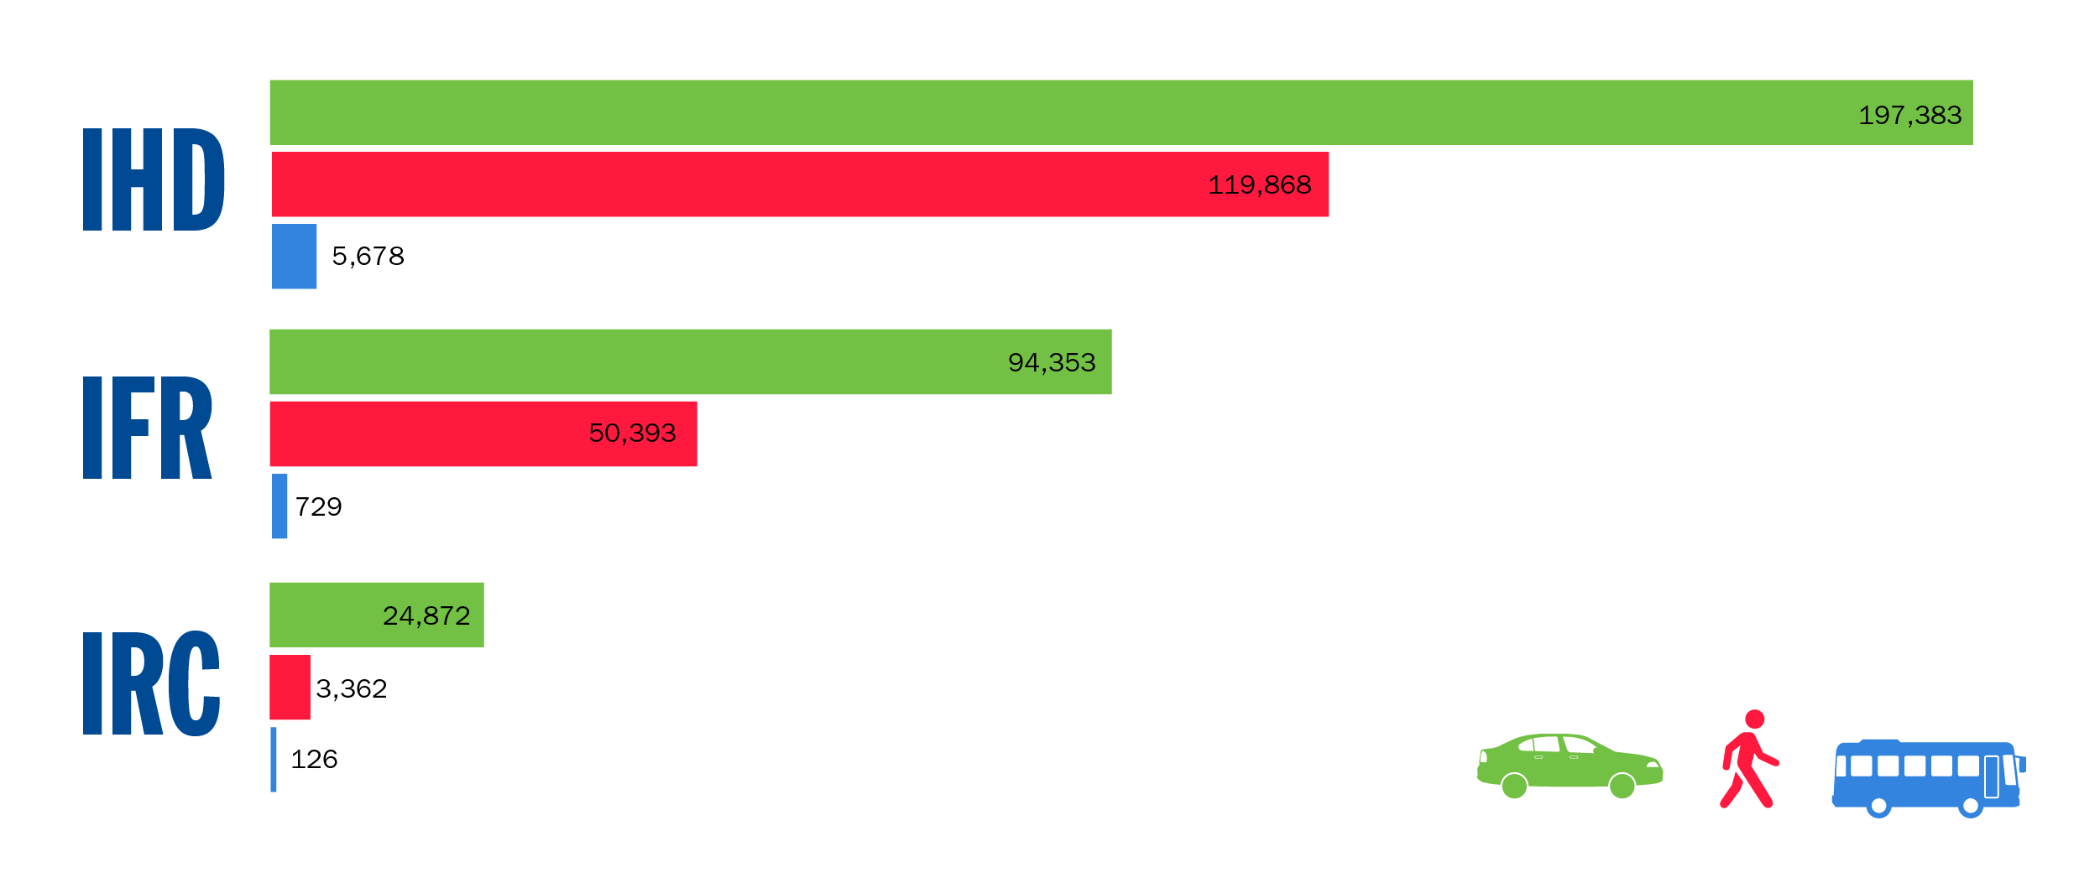



Budget Targets
IHD
IFR
IRC
197,383
94,353
24,872
119,868
50,393
3,362
5,678
729
126

Slide 3
Objectives
Strengthen Brand
Increase Sales Volumes
Increase Revenue
Reduce Costs
Increase Online (and Direct) Sales
Increase Marketing Effectiveness
Build Long-term Customer Relationships

Slide 4


SWOT Analysis
Strengths
Largest Ferry Operator
Unrivalled choice of routes and sailings
Improved travel communication
Extra loyalty club
Year round schedule
New timetable on IFR route
Unique port locations with excellent access to road and rail networks
City Centre location Dublin (ISS)
Weaknesses
Additional fees added to booking (fees and dues, SECA charges)
Reduced frequency
Loss of speed message
Extra loyalty club changes
Lack of tangible differentiation
Low brand perception in ROI market
Irish Ferries market leader in ROI market
Wifi slow/non existent
Stress of driving
Stena Europe nearly 40 years of age
Perception of ferry travel
Drydock issues
Minimal communication with Extra loyalty club members
Families not engaging with emails as much as couples/singles
Sembo – basic product – difficult to book
Poor customer service
Length of journey time

Slide 5
SWOT Analysis
Opportunities
Act like Market Leader
Utilise new sponsorships to grow share
Targeting the younger generation
Product choice
Finding new markets to talk to
Destination marketing
Duty free (Brexit)
Fastest crossing from South Wales to Ireland
Direct route to France
Dog kennels on IRC
Implementation of a new CRM system
Retention campaign for our Extra loyalty club members
Database only offers to different segments of the database
New digital marketing channels
Our People
Threats
Irish Ferries new ship to launch mid 2018
Loss of Market Share
Customer Switchers
Brexit implications
Audience fragmentation
Late bookings
Irish Ferries – National carrier, ‘Irishness’
Epsilon timetable
Media spend in ROI
Fluctuation in exchange rate
Cost of ferry travel versus flying and hiring a car
The introduction of GDPR

Slide 6
Challenges
Exchange rate sterling is still weak – direct impact of BREXIT affecting inbound passenger to ROI from GB
Ferry market flat - albeit Tourism Ireland reports -6.4% reduction on visitors from GB – Jan – Jun 2017
Irish Ferries will introduce new tonnage Summer 2018 on Dublin to Cherbourg and in Autumn head to head on Holyhead . This will severely impact on travel market on IHD and IRC.
New timetable on IFR gives more opportunity to grow market v IF on Pembroke
Potential loss of business from life extension on Stena Europe/Linkspan upgrade at Fishguard could hit booking volume short term but should not affect long term
Vat impact from Irish Revenue on small vans
Credit Card charge changes ( Jan 2018)
BREXIT uncertainty – Border controls
Markets are stable no major downturns or growth expected

Slide 7



St Patrick’s Day
Direct
2 sends launch 16 March and final reminder 18 March
Online activity
Update Stena Line logo, green background, banners, SO Listings, RLP and webpages
Social media
Boosted post, social media link and carousel ads,
Display
Display ads to go for 3 days only
Media
Media drop to GB and ROI
OSS activity
Samples in shop, green Guinness, offers in shop and crew wearing St Patrick's day hats
RAKs
Vouchers handed out onboard for 20% off in our onboard shop
Tourism Ireland
Offer on ezines,
TravelZoo
Offer for both ISN and ISS
Content/partnership
Teaming up with Capital radio to bring them to Ireland for St Patrick’s day
Direct
1 send launch 16 March, OSS offers featured on WOB
Online activity
Banners, SO Listings, RLP and webpages
Social media
Boosted post and post for turning the ship green
Display
Display ads to go for 3 days only. PPC, offers are managed via sitelinks hence no upweight is required as long as the always on campaigns are running.
Media
Media drop to GB and ROI, turned the ship green
OSS activity
Offers in shop – Jameson and Guinness backpack
RAKs
Lotto tickets left on car windscreen

Slide 8


Results
Total bookings 6,101
Total revenue: £30,257
Total bookings 6,151
Total revenue: £55,036

Slide 9
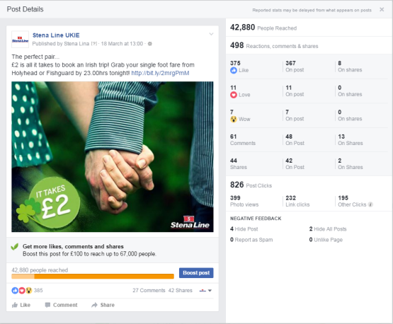
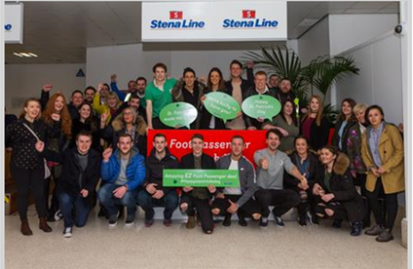
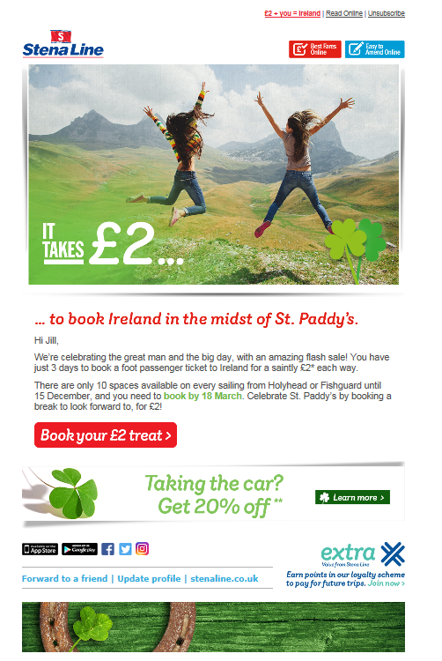
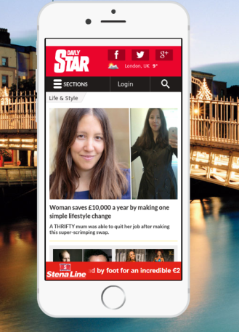
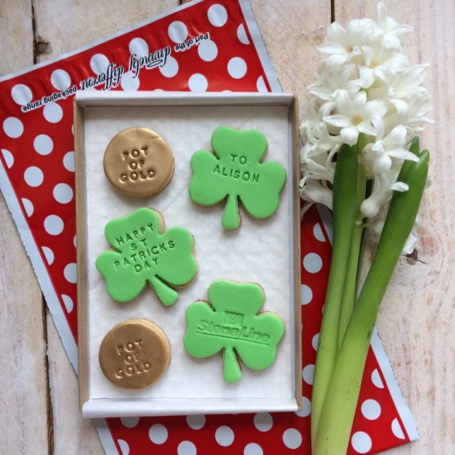

Creative

Slide 10
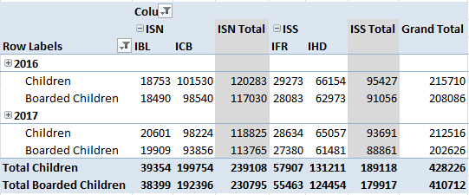
Kids go free – IBA Campaign
Kids travel free all year
Launched 23 April
Finished 16 August
IBC, IBL, IHD, IFR and IRC
Activity
Radio
Press
Cinema
Online-
Social
Overlays
PPC
HPTO
3,619
£819,822

Slide 11
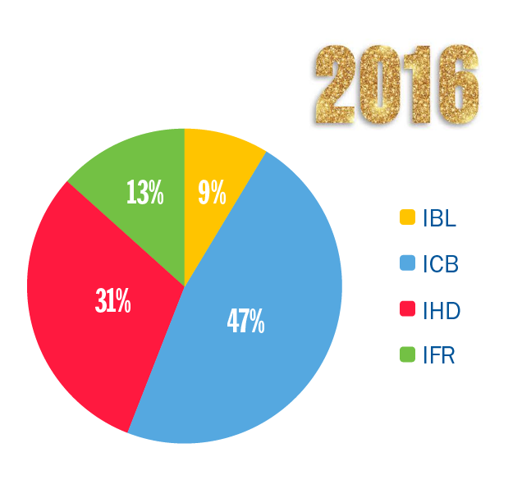
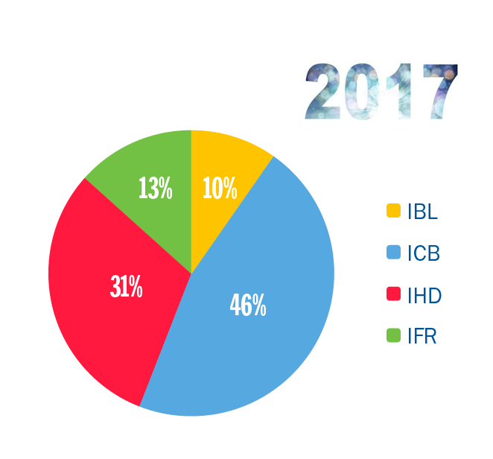
Kids go Free Results

Slide 12
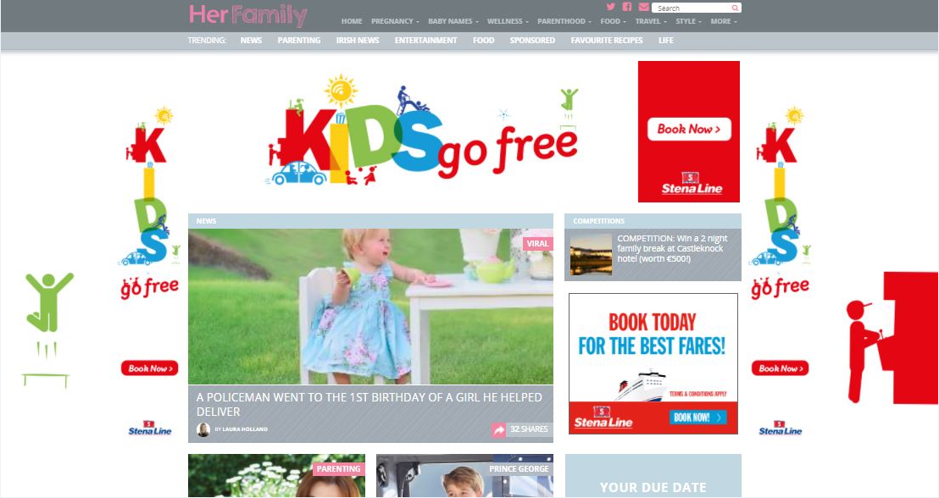

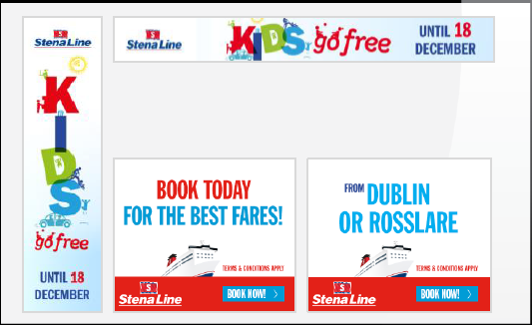
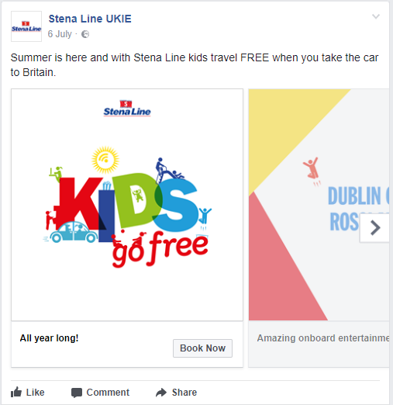
Creative

Slide 13
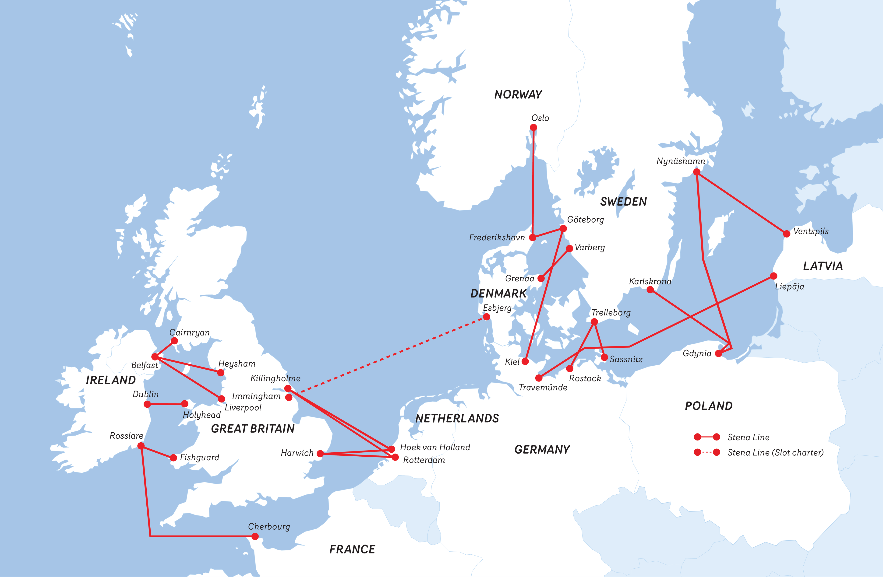
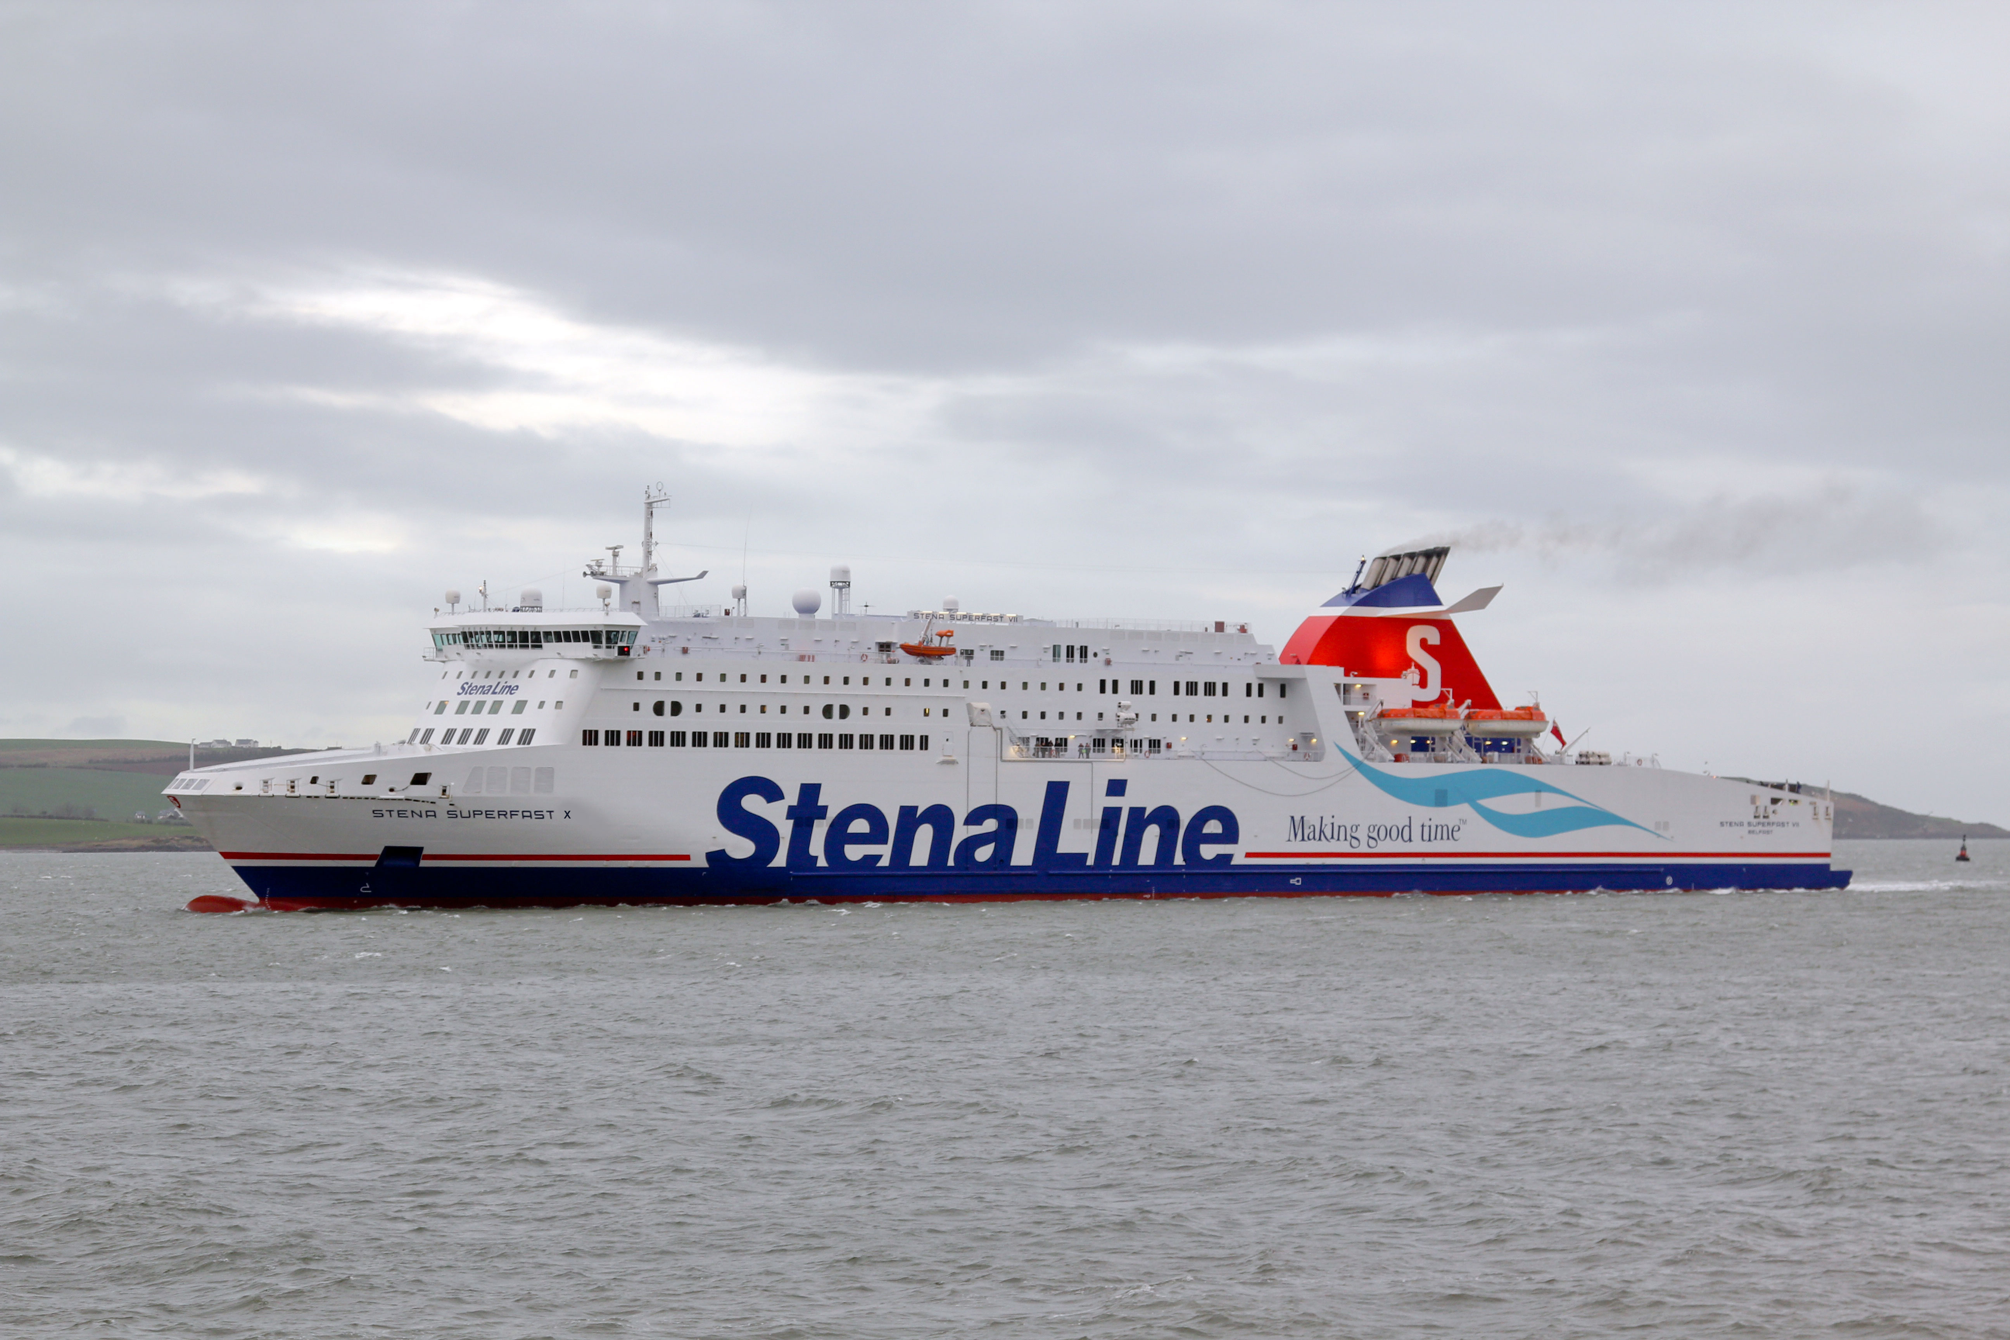
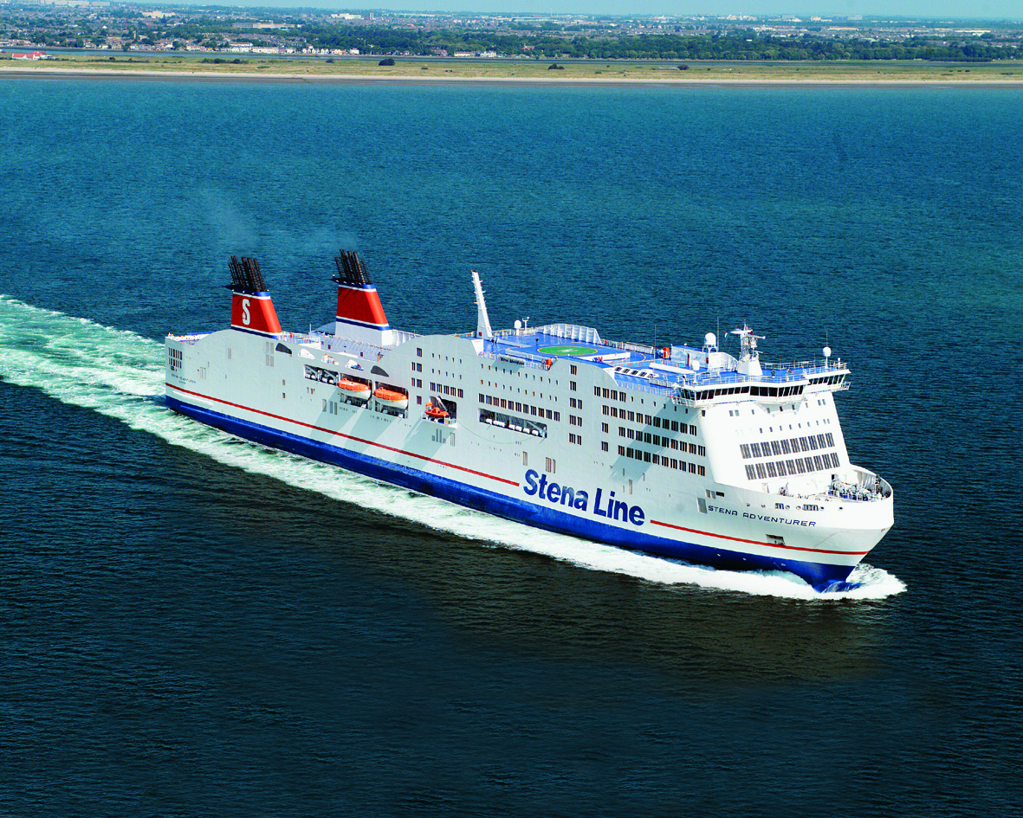
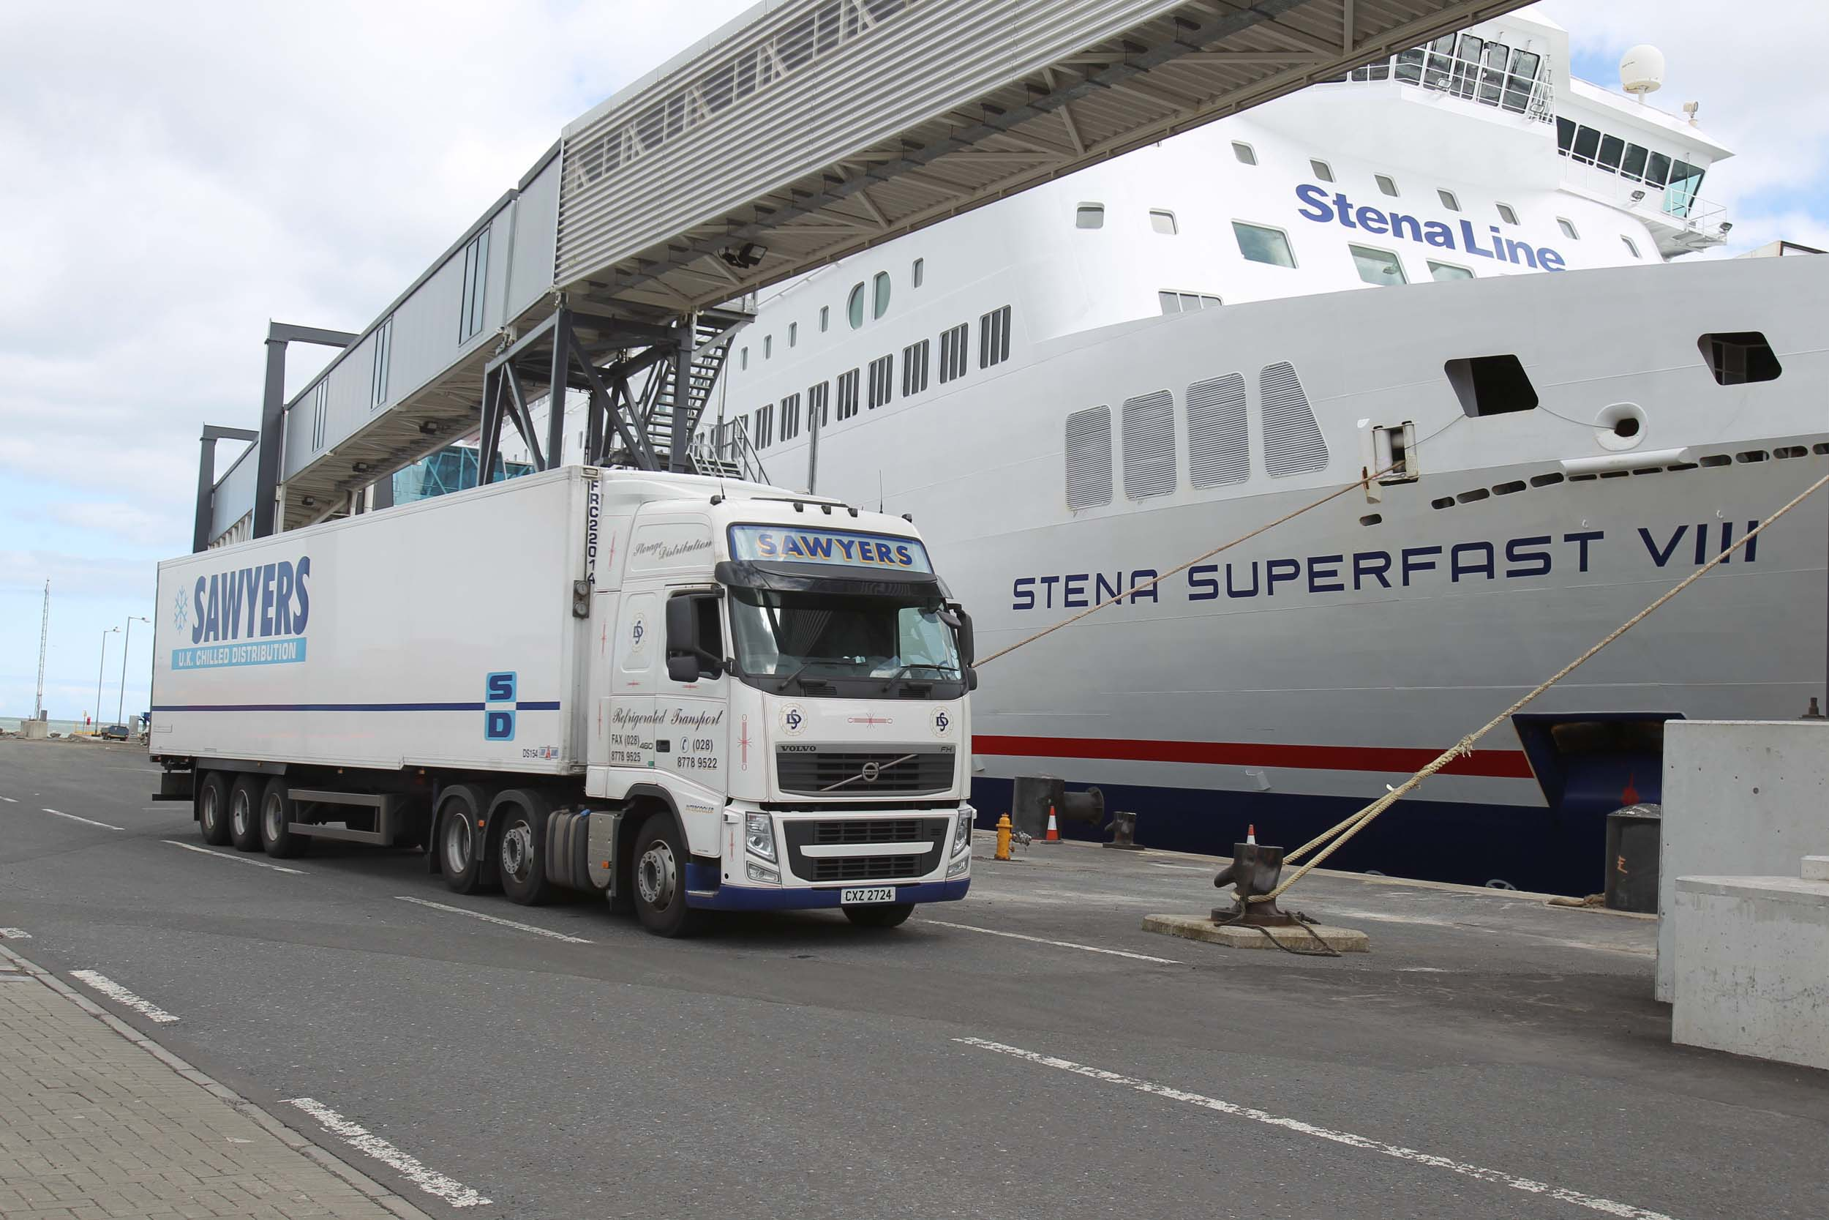
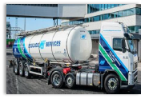
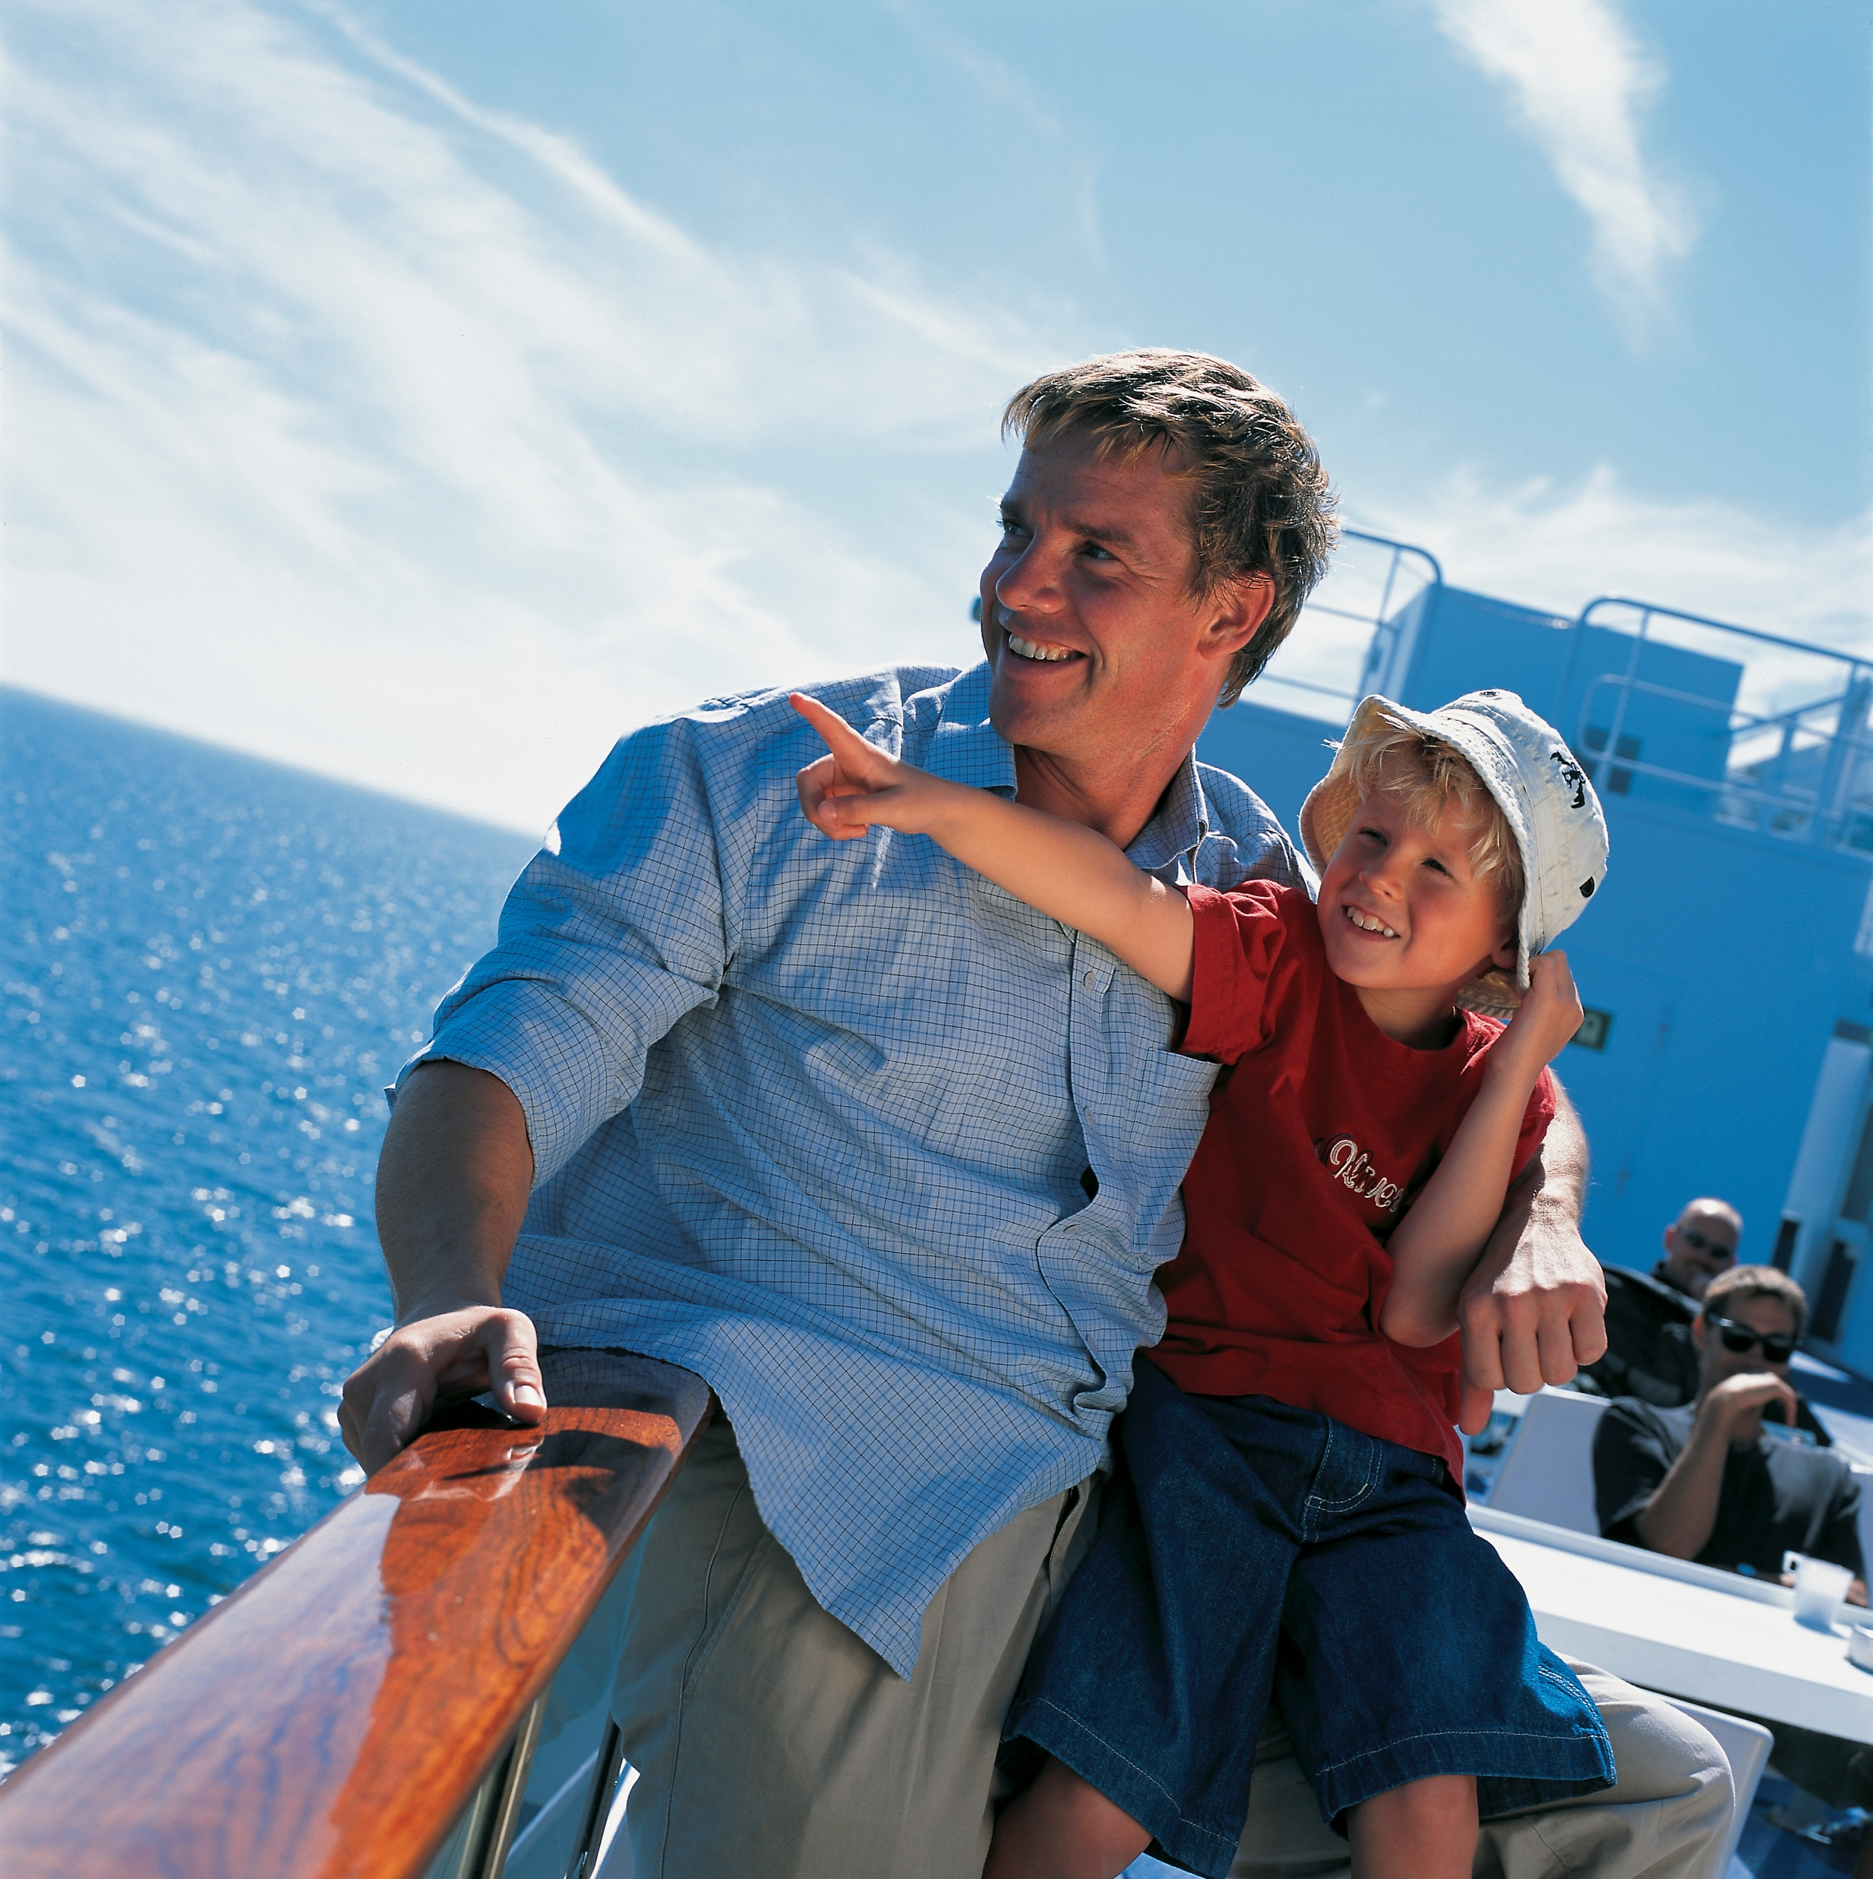
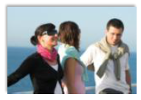
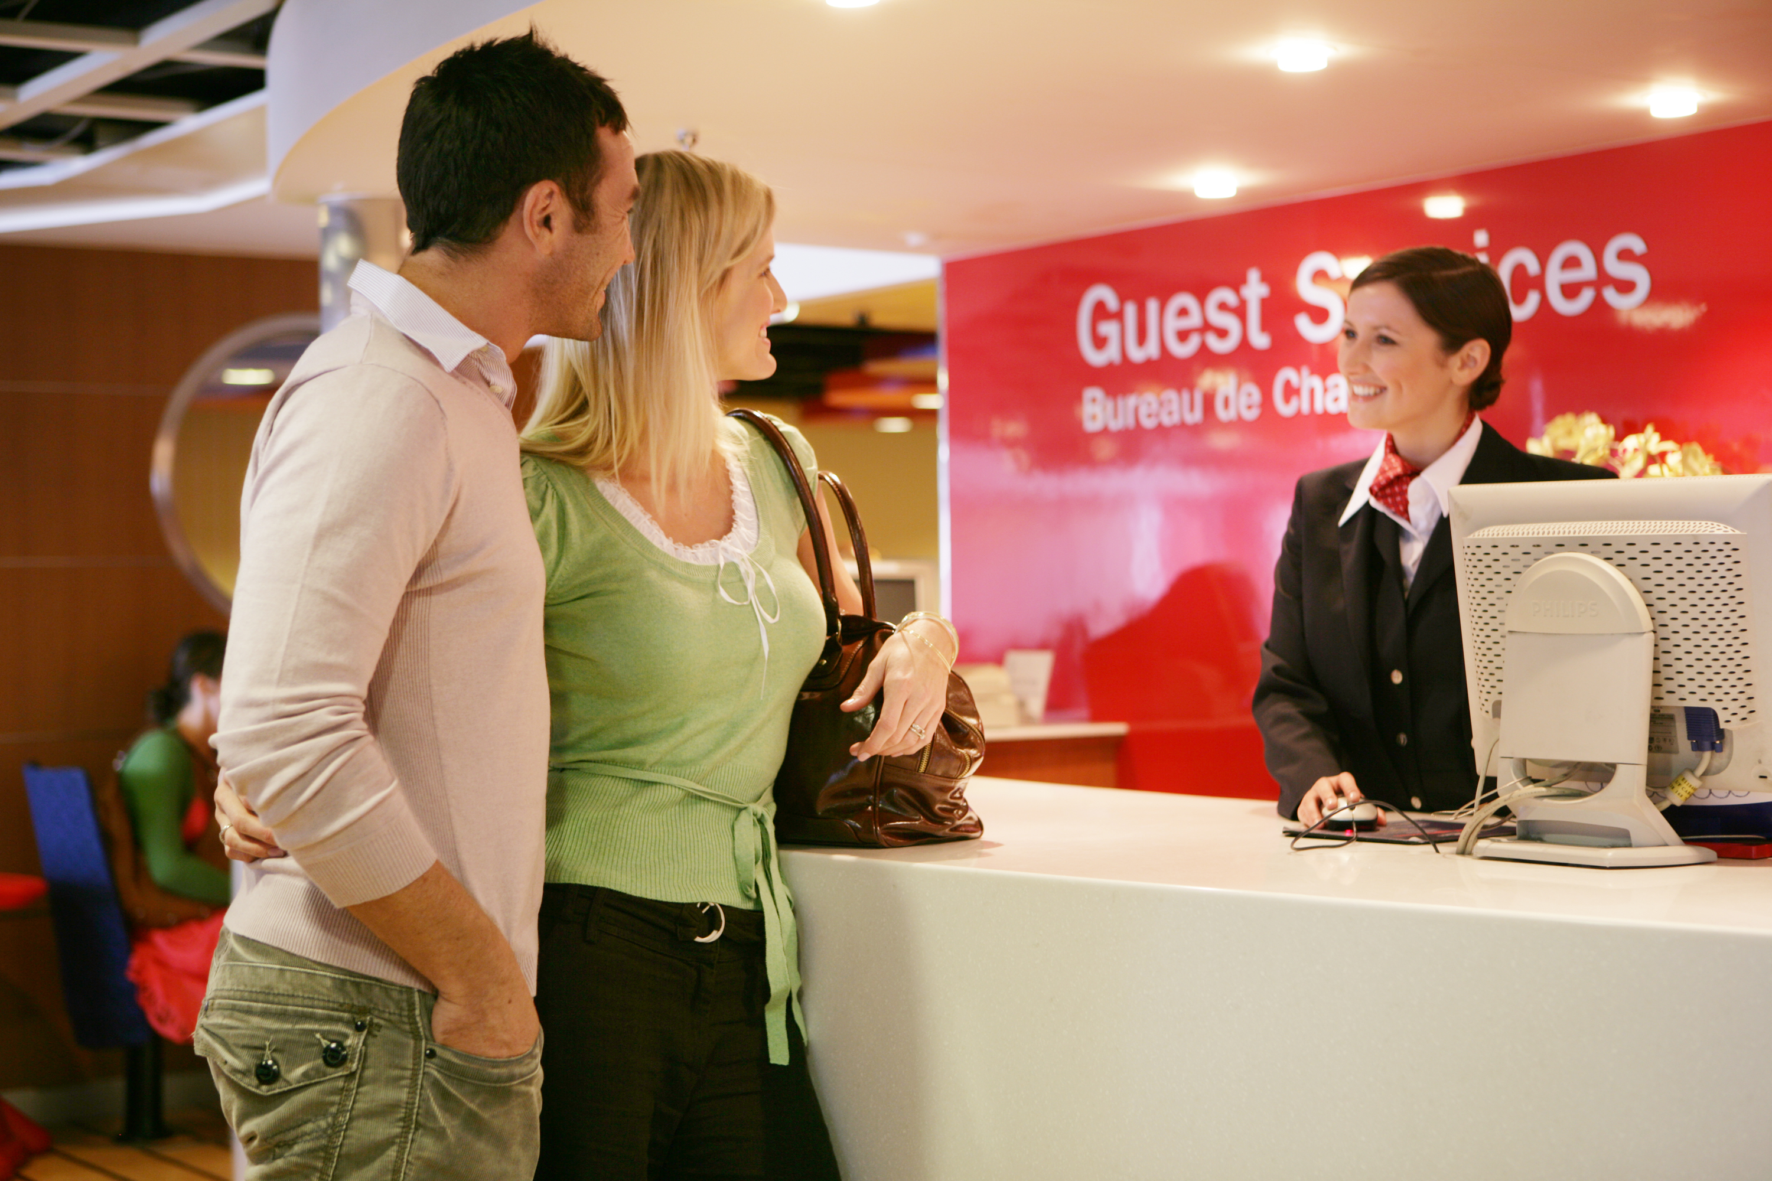
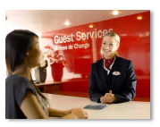
Budget 2017 – key numbers
Reliablity
99.4%
Market
Travel
IHD 40%
IFR 48%
ICR 20%
3 Routes
4661 sailings
180 per week
Passengers
ISS 1276482
IHD 875706
IFR 316074
IRC 84702
Freight Units
285503 ISS
IHD 227,676
IFR 30849
IRC 26978
Vehicles
322,956 ISS
IHD 201555
IFR 92236
IRC 28165
£15,989,109
Net Profit
IHD £16,178,147
IFR £443,819
ICR - £632,857
Scandinfo
56% - ISS
IHD 62%
IFR 58%
IRC 42%
£145,496,842
Revenue
IHD £100,543,513
IFR £ 24,088,616
IRC £20,864,714

Slide 14
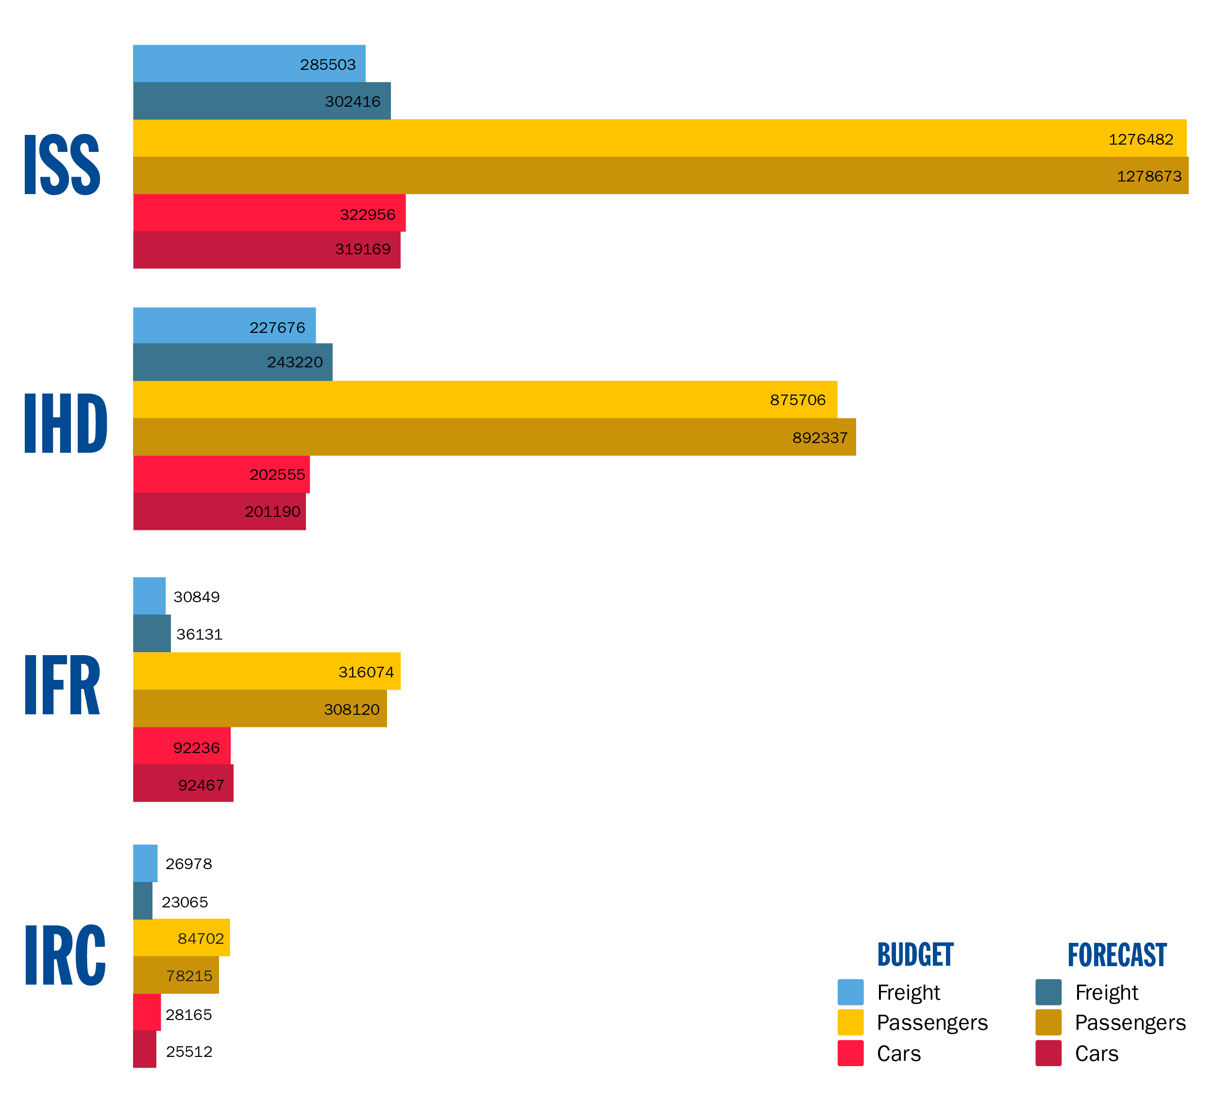
Budget versus Forecast

Slide 15
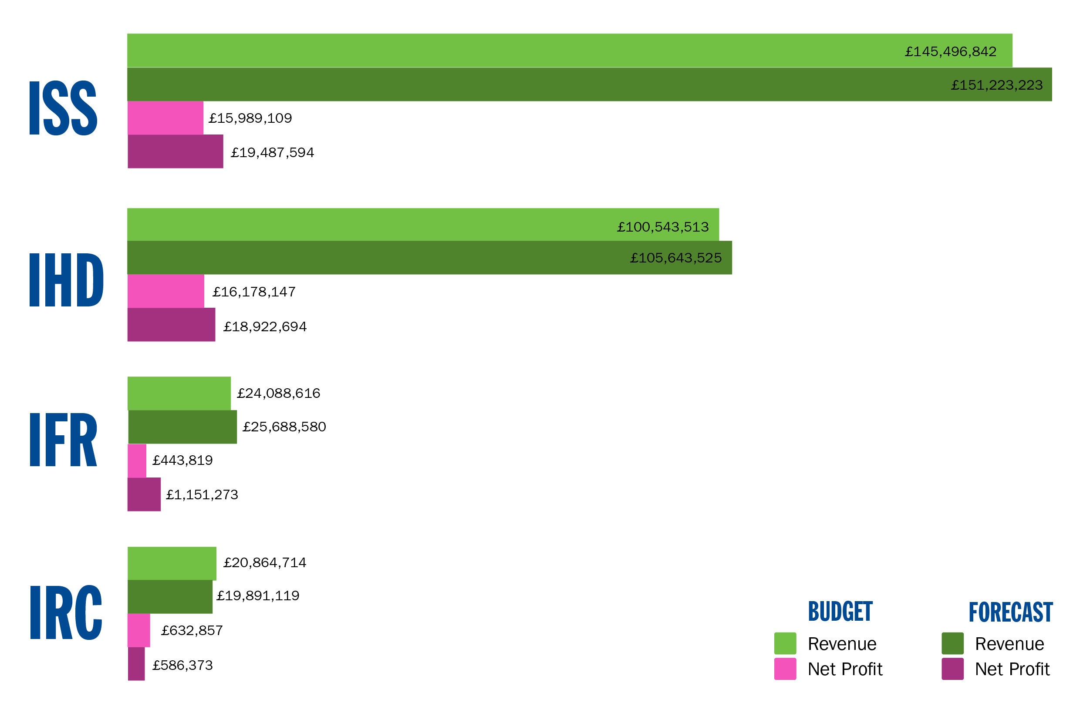
Budget versus Forecast

Slide 16
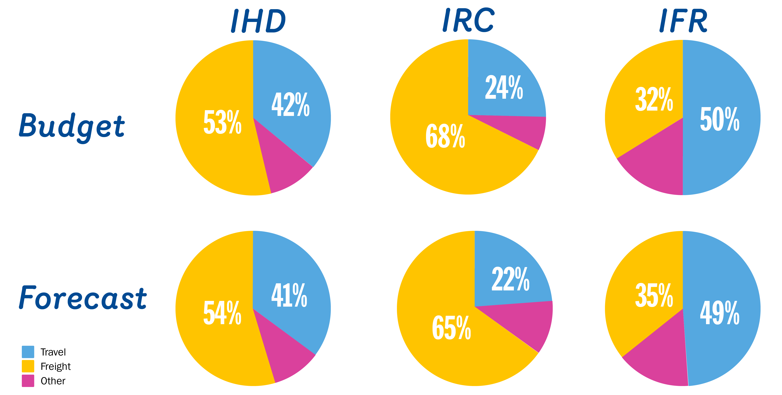
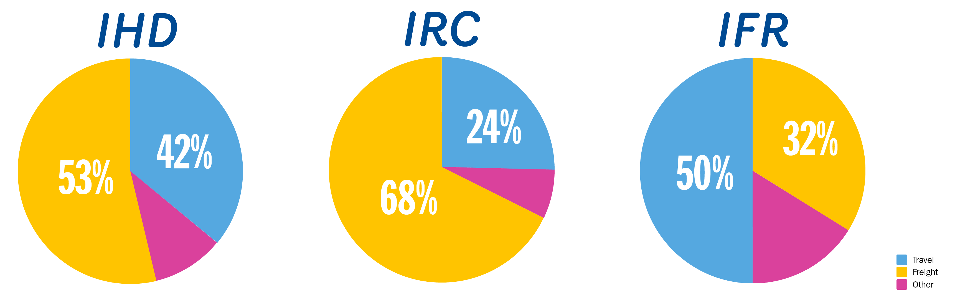
Budget versus Forecast - Market Share

